Slide 1
GOIDEN HOME 11
GOLDEN VISA ELIGIBLE EU RESIDENCY INCLUDED
Commercial-to-Residential Conversion
Ampelokipoi 丨 Near the Acropolis 丨 Metro station 450m

Slide 2
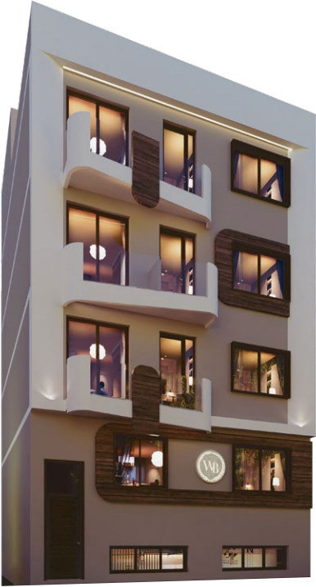
The Renderings are for reference only.

Slide 3
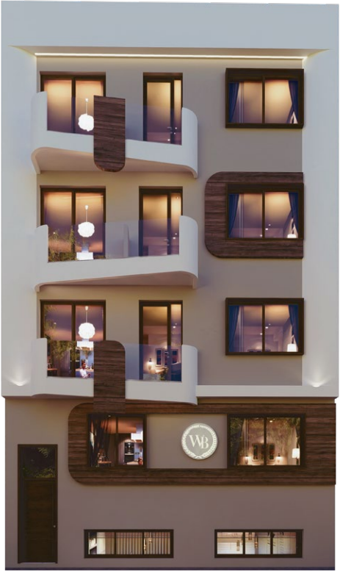

The Renderings are for reference only.

Slide 4
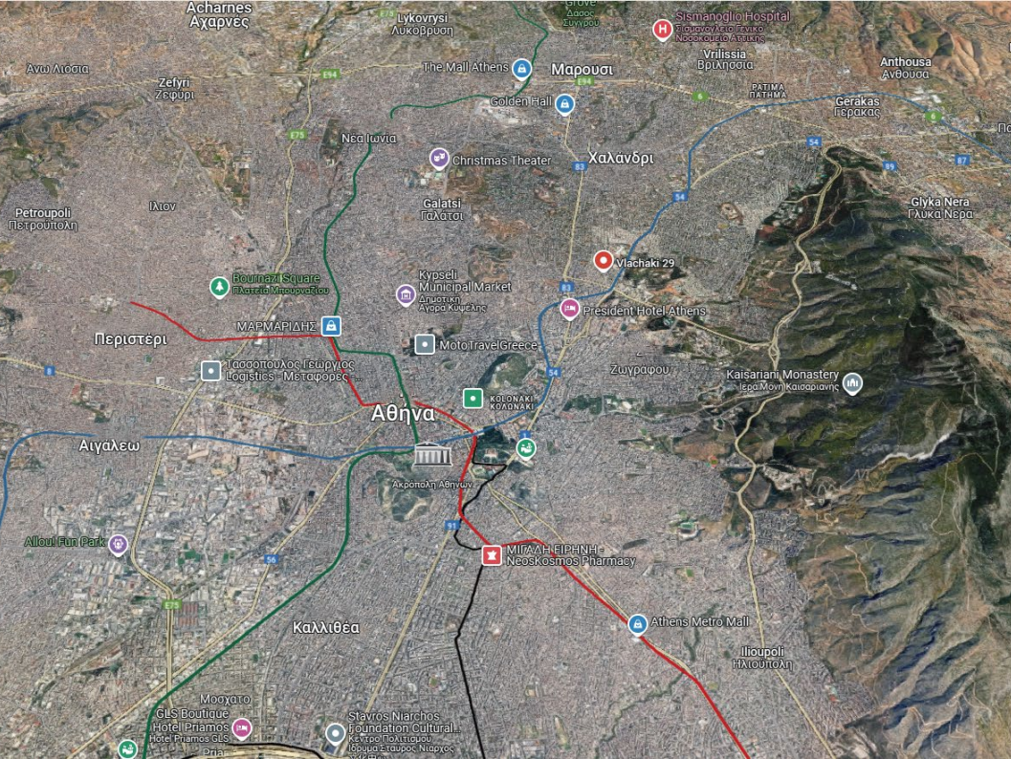








Ampelokipoi
Located in Ampelokipoi, downtown Athens, the proj- ect boasts a pleasant and clean neighborhood. The area is home to numerous Athenian government agen- cies, including the Hellenic Police Headquarters, the Greek Court of Appeal, and the Athens Government Oﬃce Building, ensuring a safe and secure env iron - ment . The area is also well- connected with the subway, hospitals, super - markets, restaurants, and cinemas. The area, primarily composed of apartments, is considered above average for the city center and is popular among young Athe- nians.
Golden Home 11
Metro station 450m
(M3 katehaki)
Acropolis
6 stops
Constitution Square
5 stops

Slide 5
1
4
3
8
10
2
9
Metro station M3 Katehaki
450m
5
6
7
NEARBY
1 Private hospital -750m
2 Cosmos Business Center -1.3km
3 General Hospital of Athens Korgialeneio - Benakeio Hellenic Red Cross -1km
4 AB store -210m
5 Asian Food Store -1.6km
6 Laiko General Hospital of Athens -1.7km
7 Hildren's Hospital Agia Sophia -1.6km
8 Henry Dunant Hospital Center -900m
9 Sotiria Thoracic Diseases Hospital of Athens -500m
10 General Hospital of Athens "G. Gennimatas" -750m

Slide 6
A strong local rental market:
where resources gather, the demand for rental housing is natu- rally strong.
The main rental population consists of diplomats, doctors, nurses, students, and white-collar families, with an overall rental rate of over 90% for the entire building, allowing investors to reap beneﬁts in both identity and income.
Golden Home 11
1
2
20+ embassies nearby
Hospital surrounding cloth
Kifisias Ave
Golden Home 11
Golden Home 11
3
4
The surrounding schools abound
Near Fortune 500 Companies

Slide 7
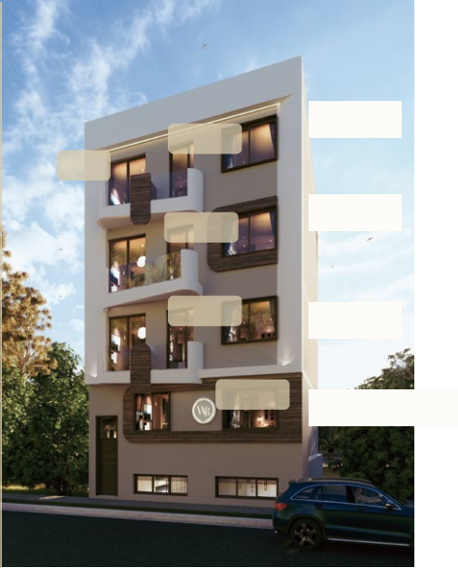














PROJECT OVERVIEW
Strategic Location
Fully Furnished
Investment Opportunity
Golden Visa Eligible
C1:
Totally SQM: 60.37
Sales sq.m: 44.18
Balcony sq.m: 16.19
C floor
B floor
A floor
Ground floor
C1
B1
A1
G1
THE DEVELOPMENT
C2
Modern style
Building
A
ENERGY CLASS
ESTIMATED
DELIVERY
Q3.2026
Hotel-style design
A1:
Totally SQM: 43.97
Sales sq.m: 40.69
Balcony sq.m: 3.28
THE UNITS
4 floors
8 units
18-44SQM
1-2 bedrooms
KEY FEATURES & AMENITIES
STORAGES
GYM
Recreation Area
Garden comon area

Slide 8



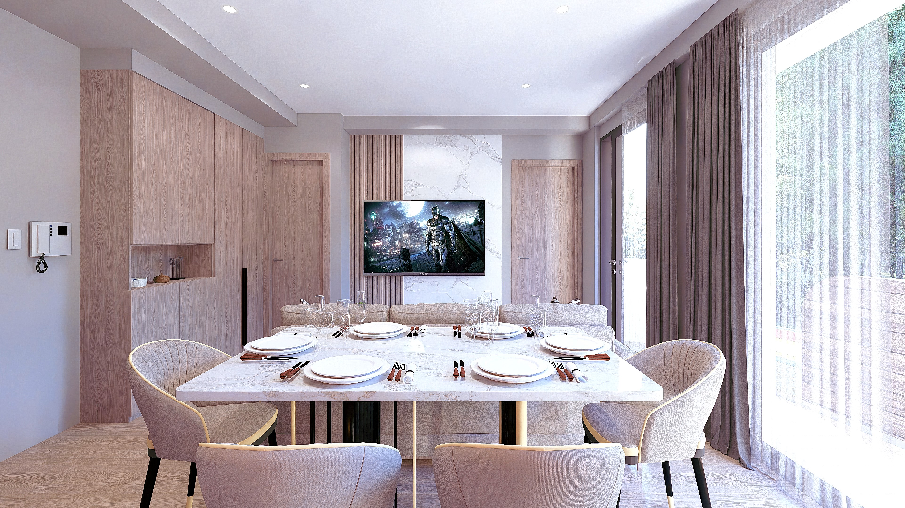

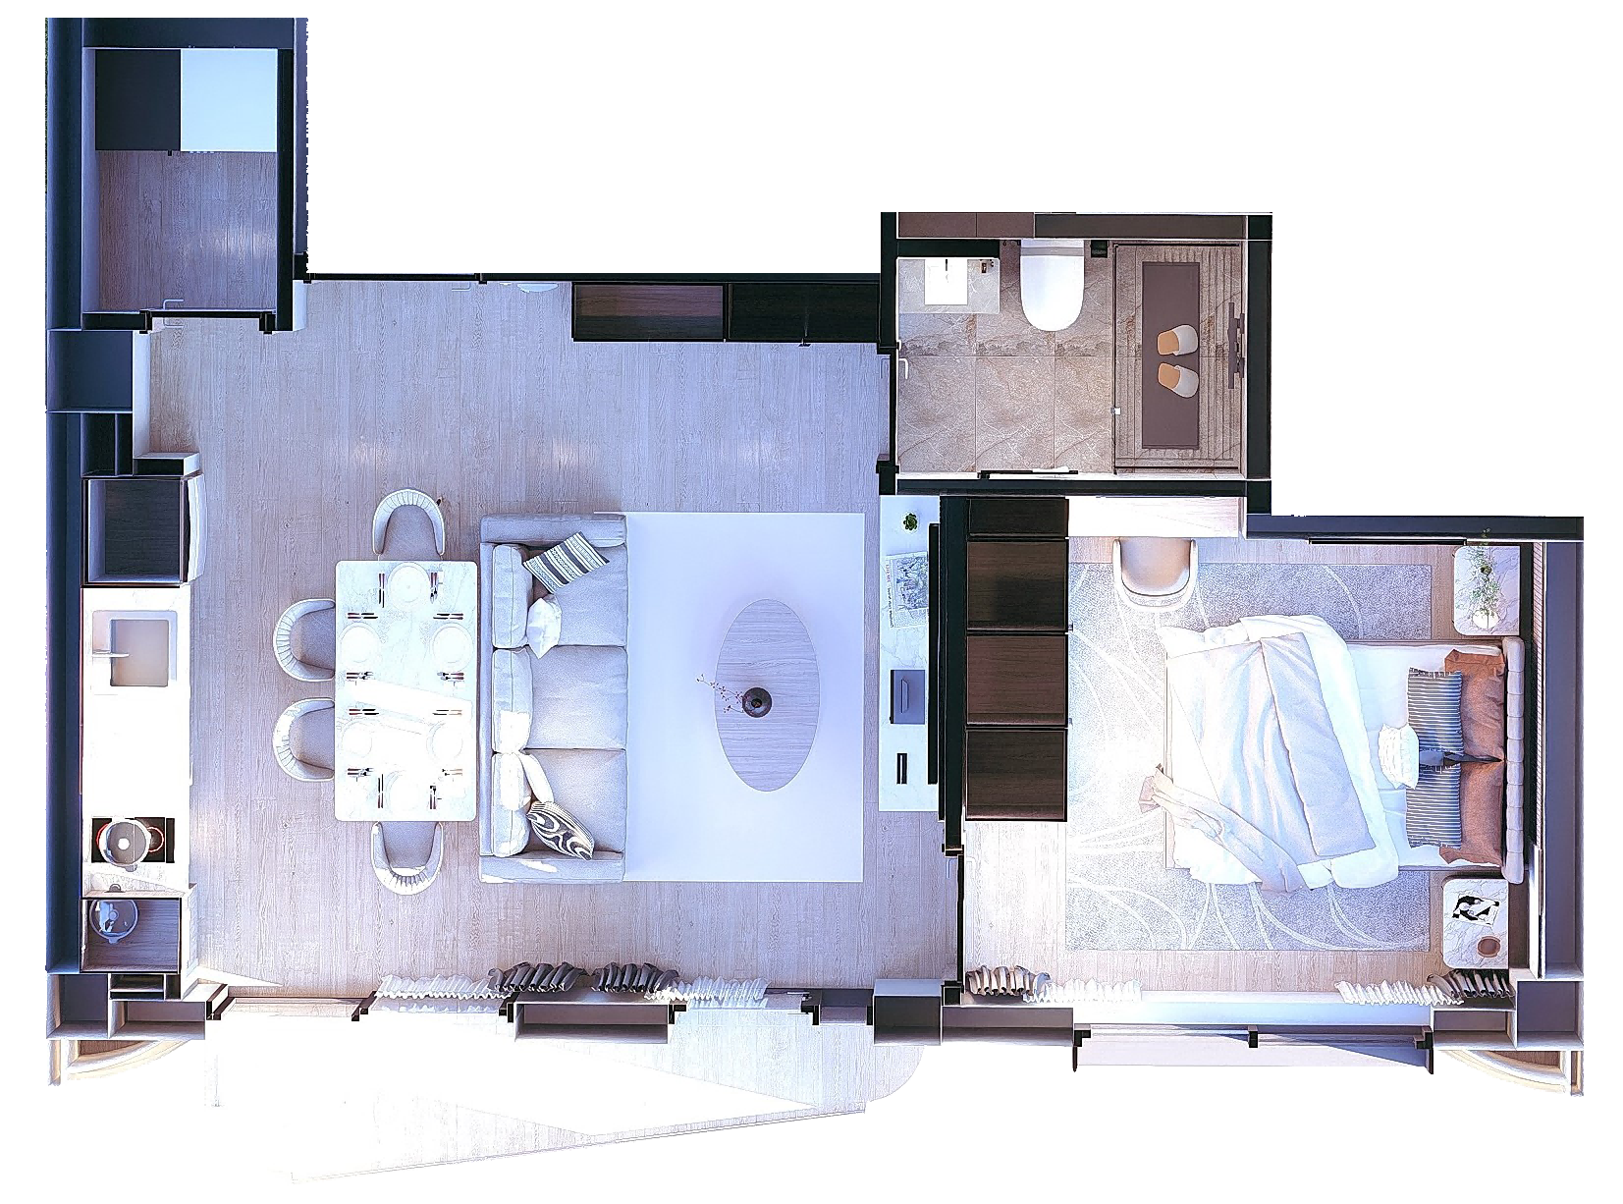
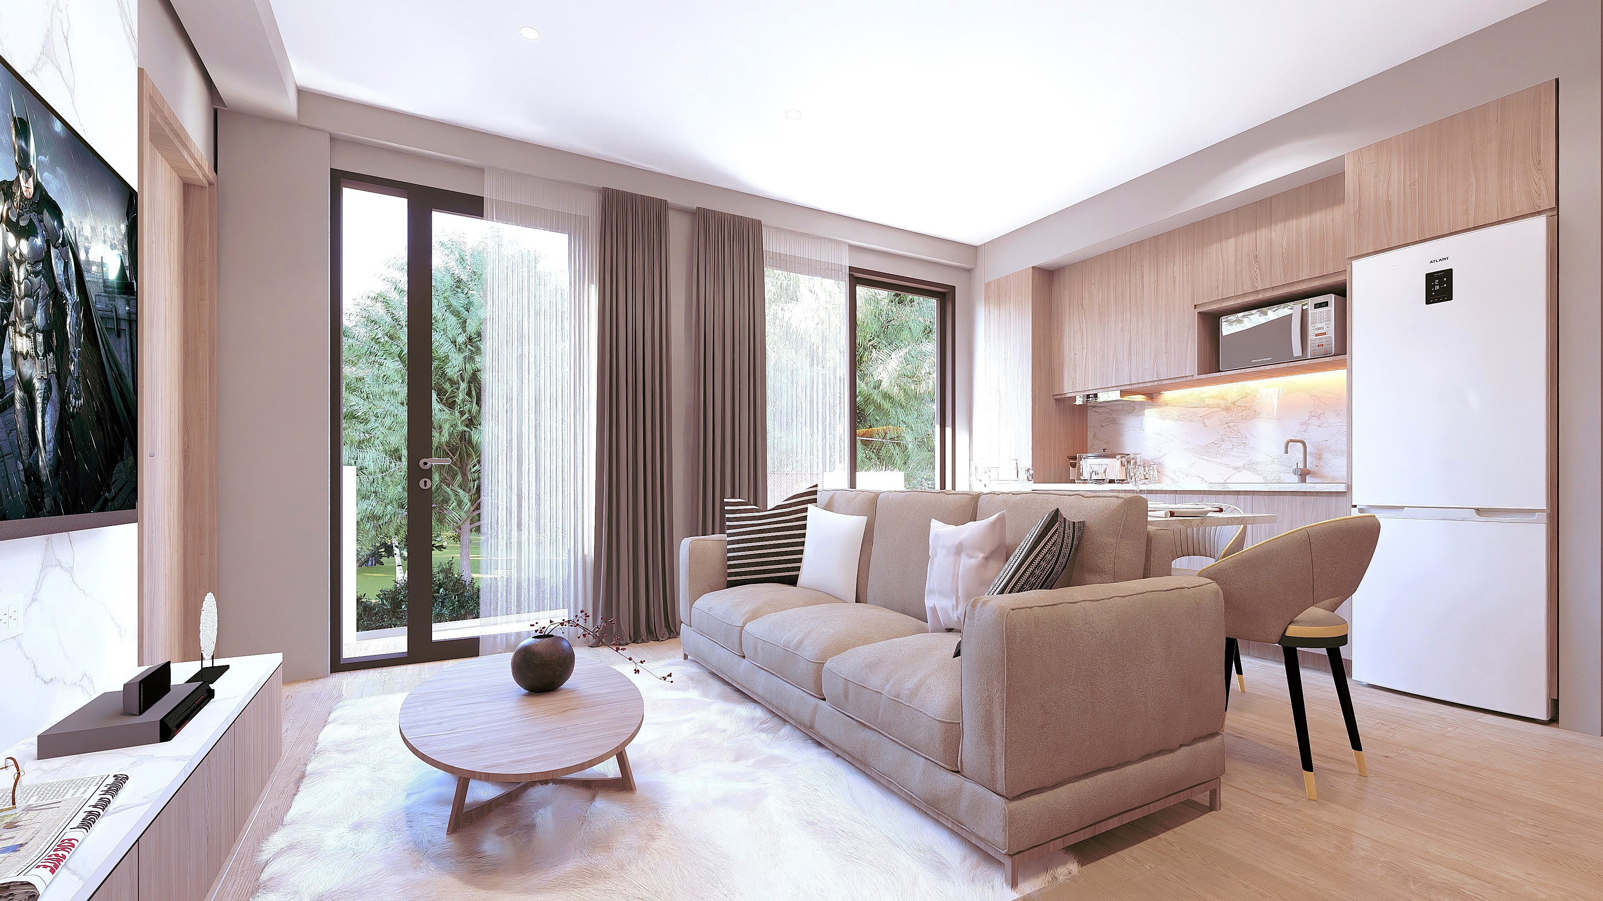
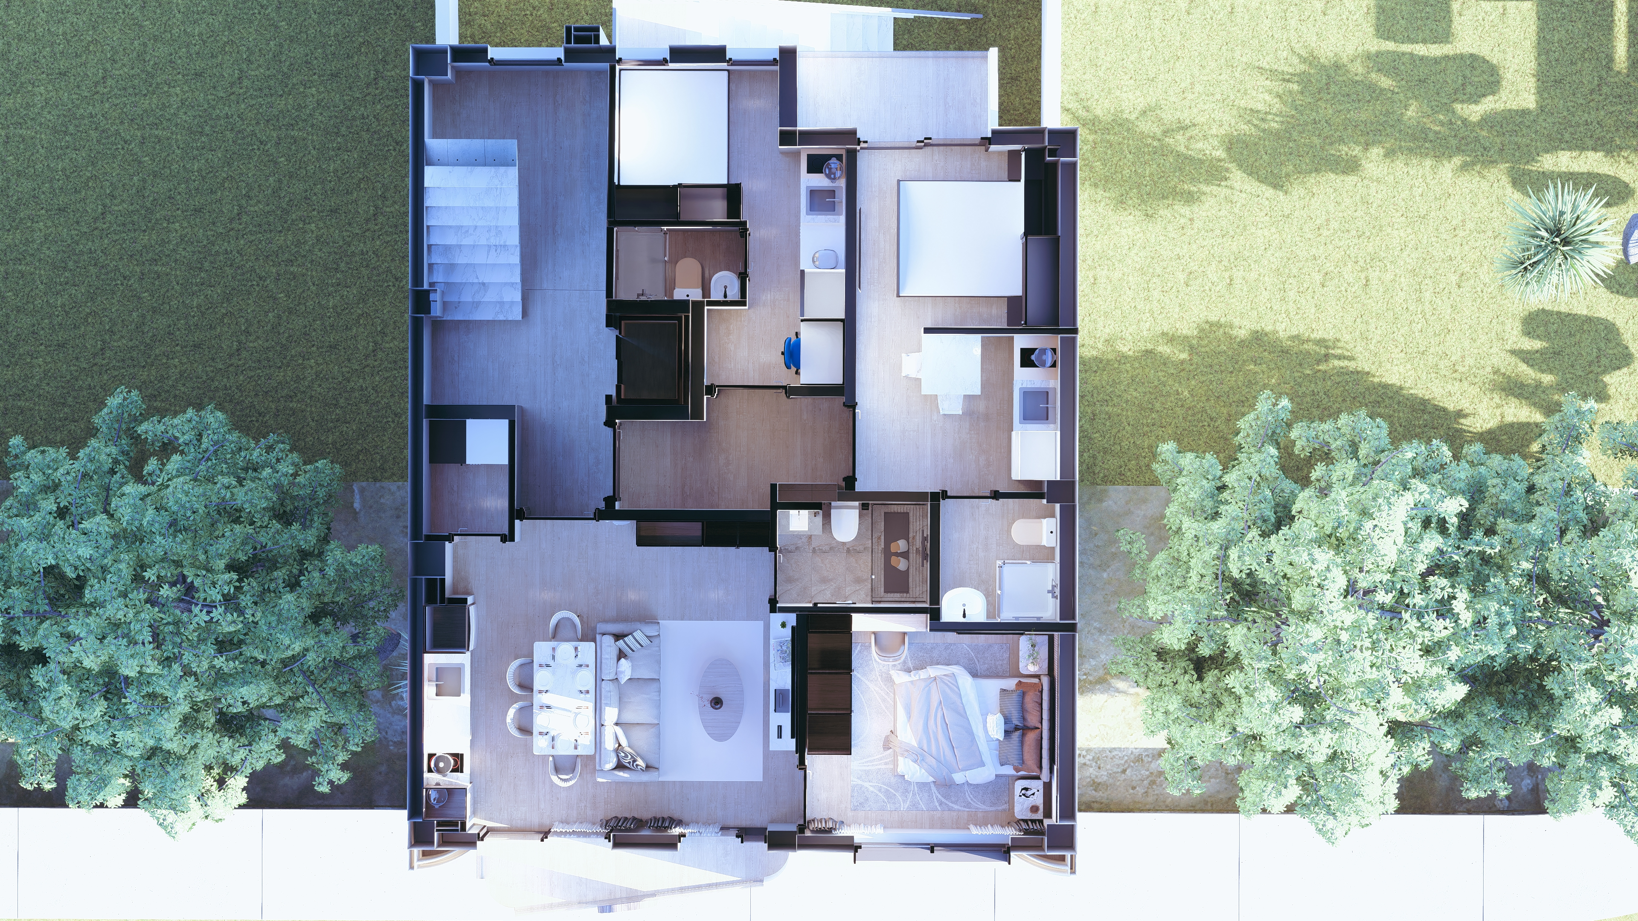




A1
43.97m²
One Bedroom types
1 BD
Kitchen
1 BATH
Balcony: 3.28m²
The renderings are for reference only.

Slide 9
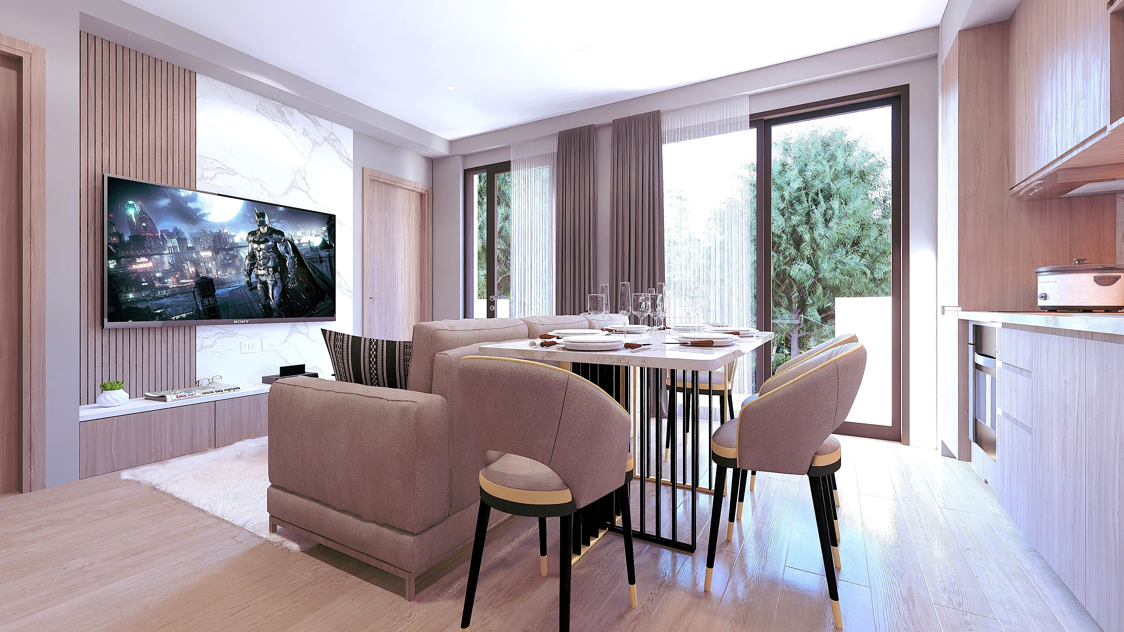
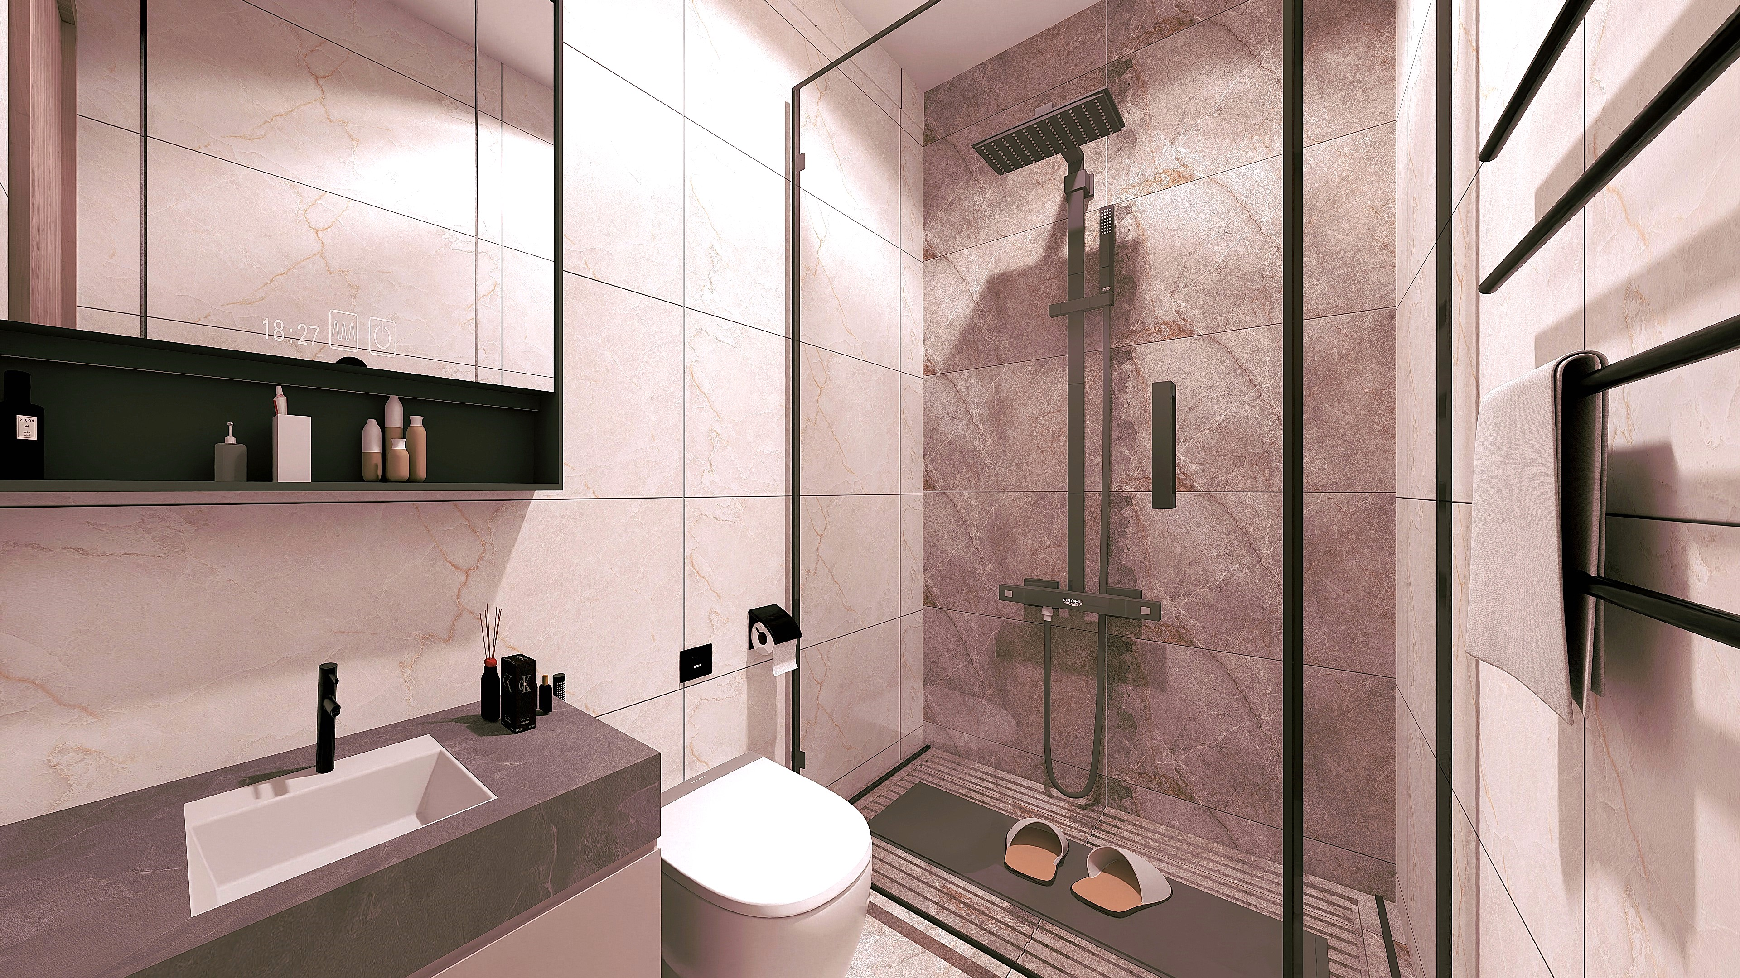
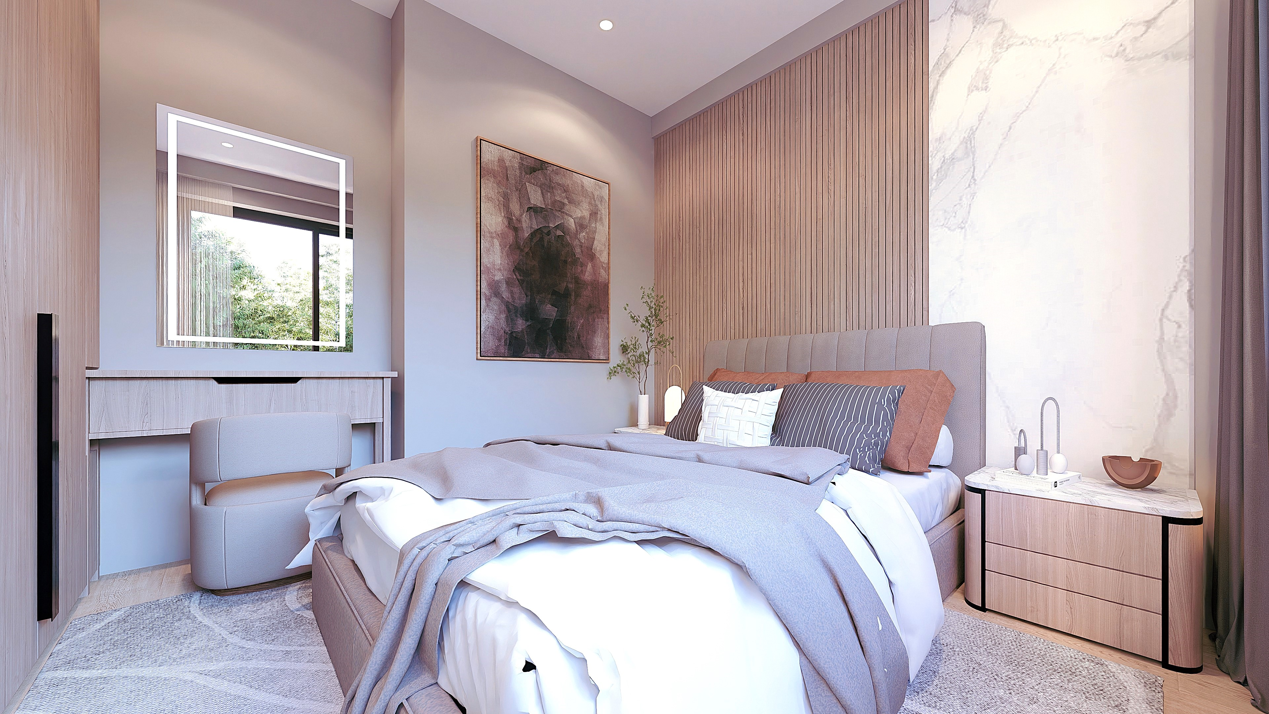
A1
43.97m²
The renderings are for reference only.

Slide 10
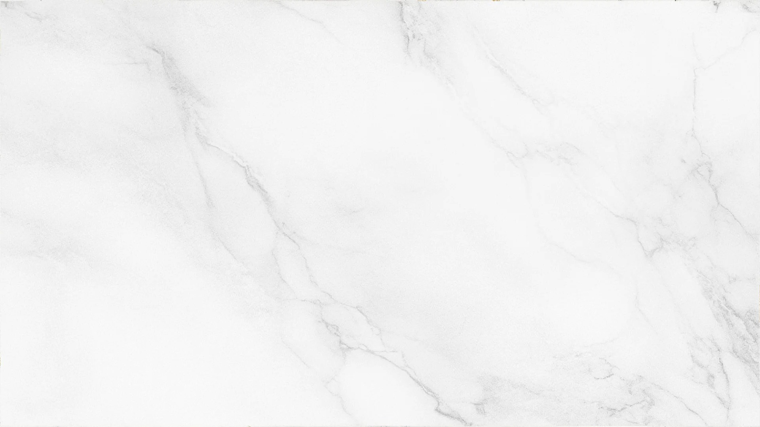
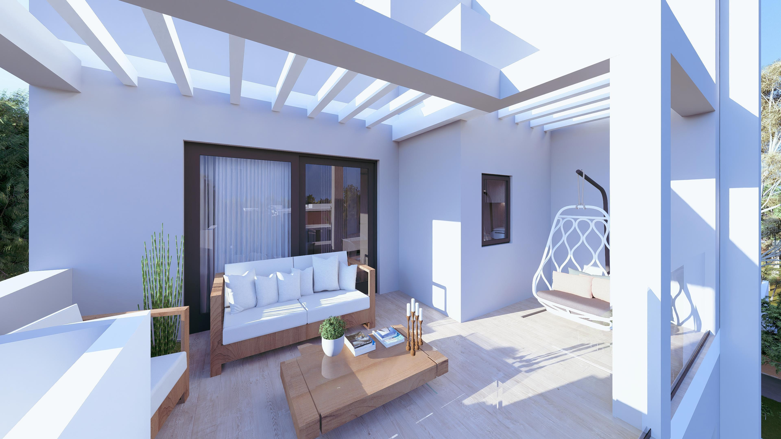
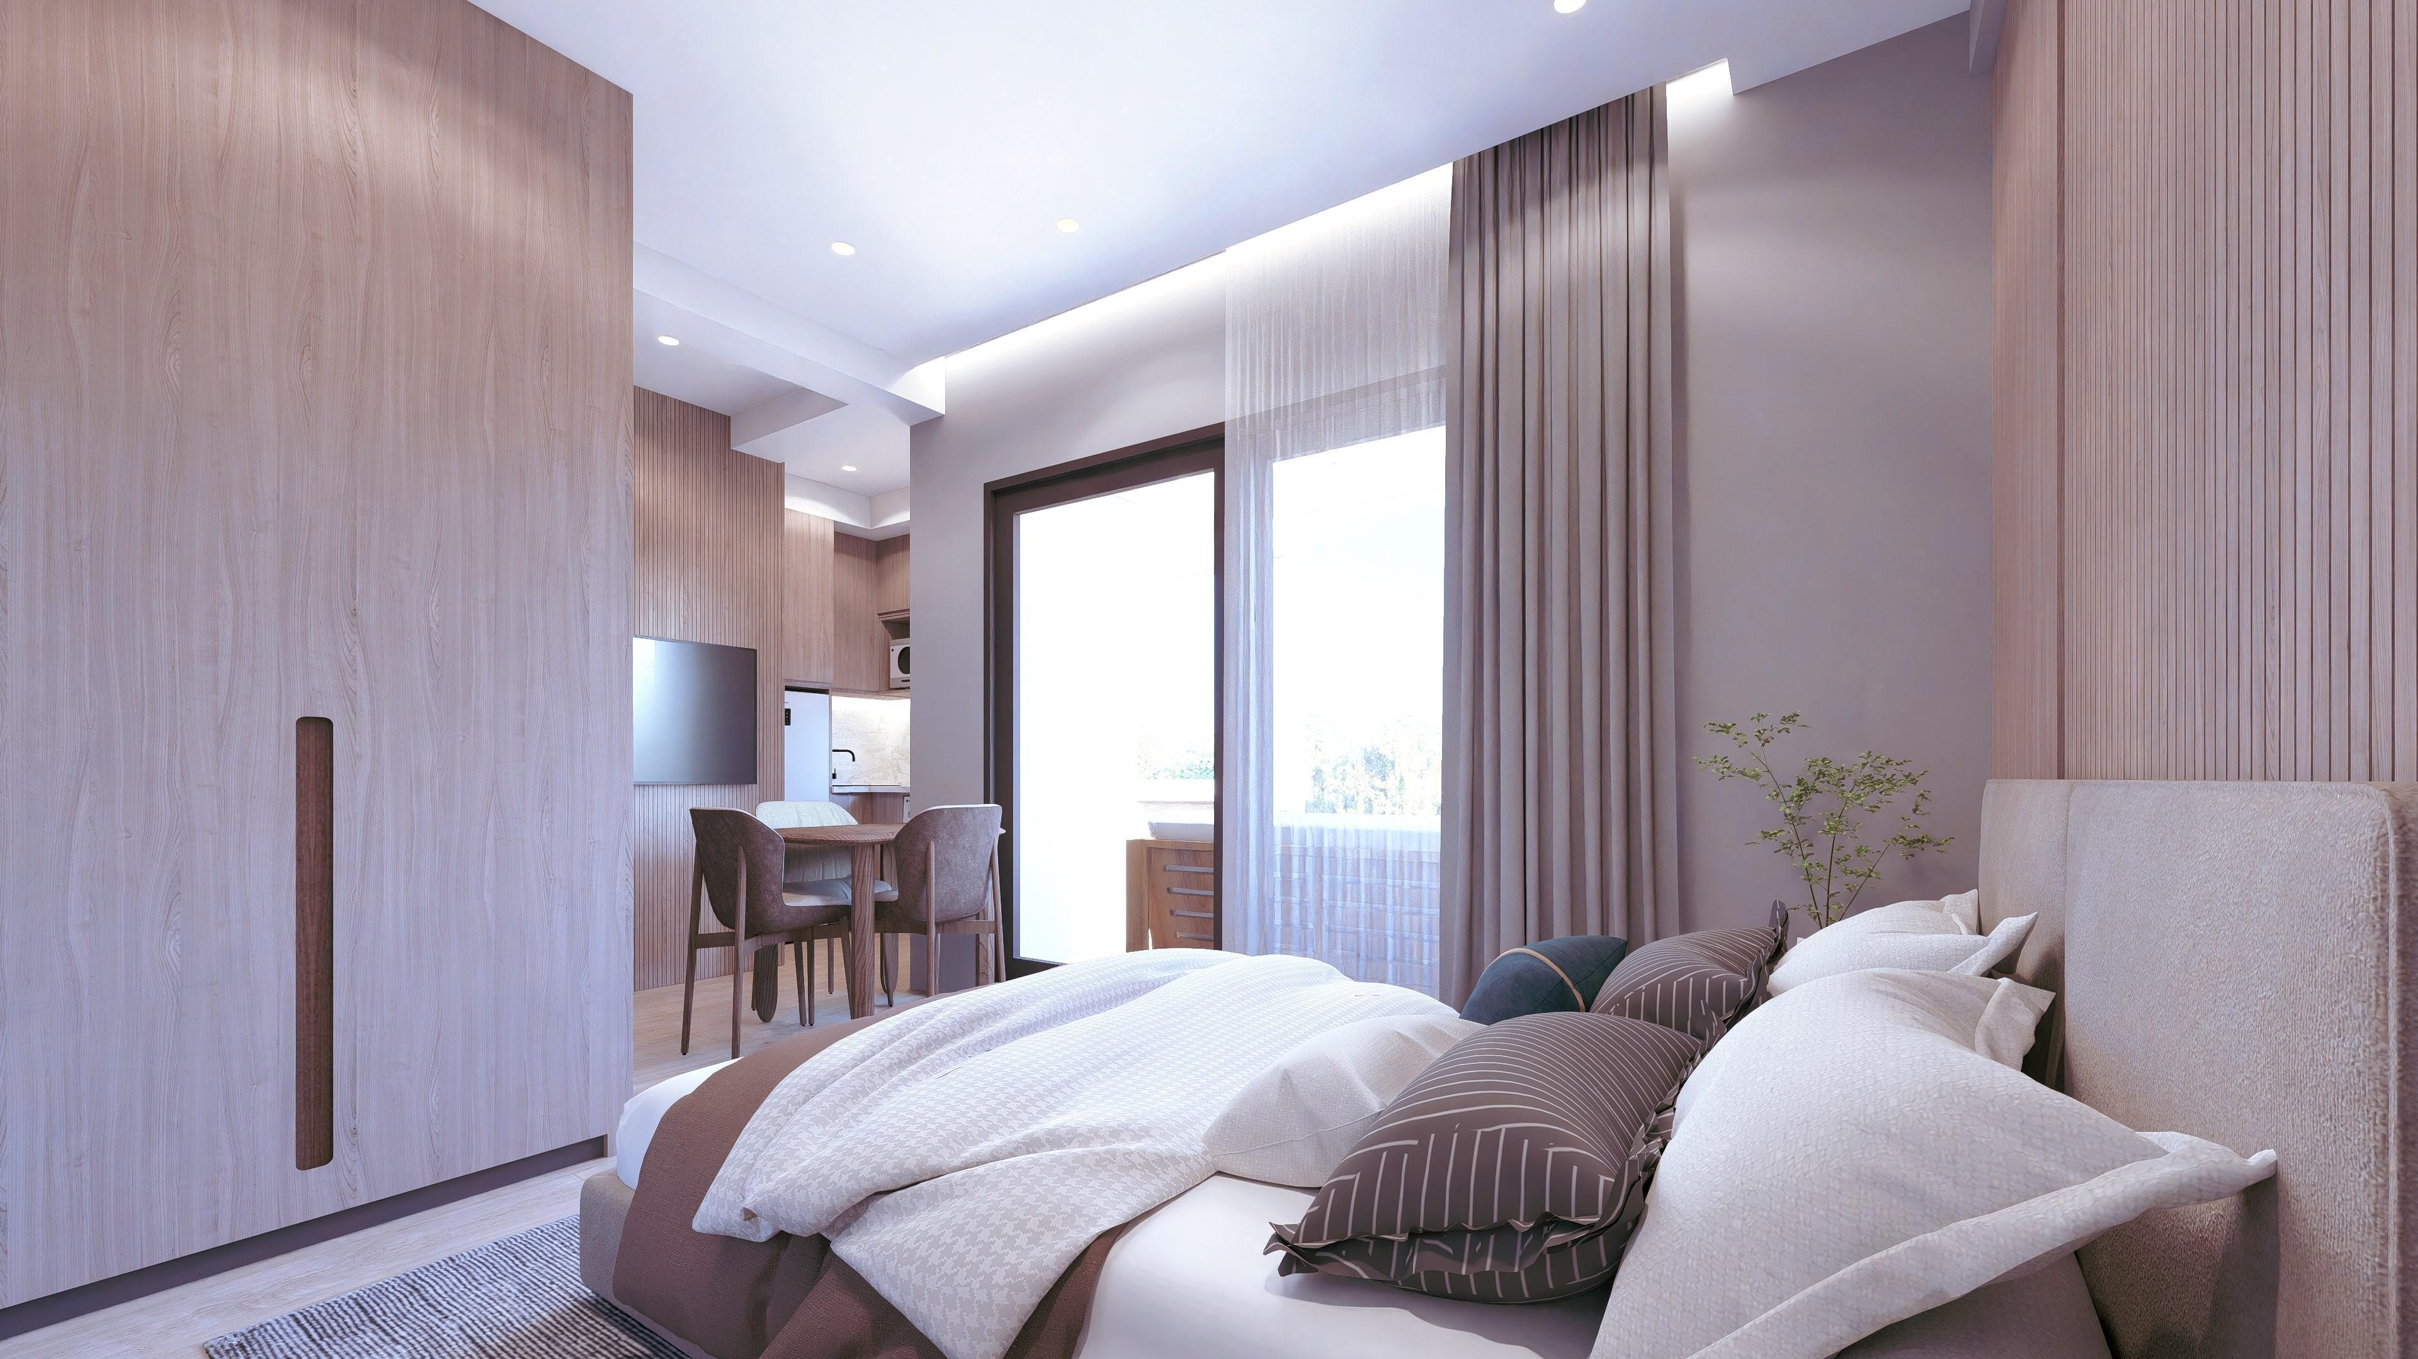

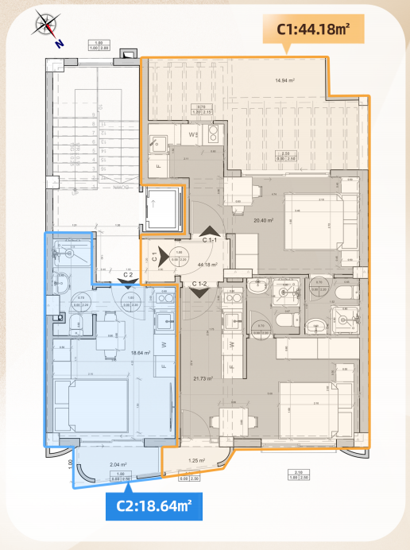
C1
studio 1
60.37m²
Balcony sq.m: 16.19
2 studios
1 BD
1 BATH
×2
1
2
Kitchen
Open Concept
Lving/Dining Raom
The renderings are for reference only.

Slide 11
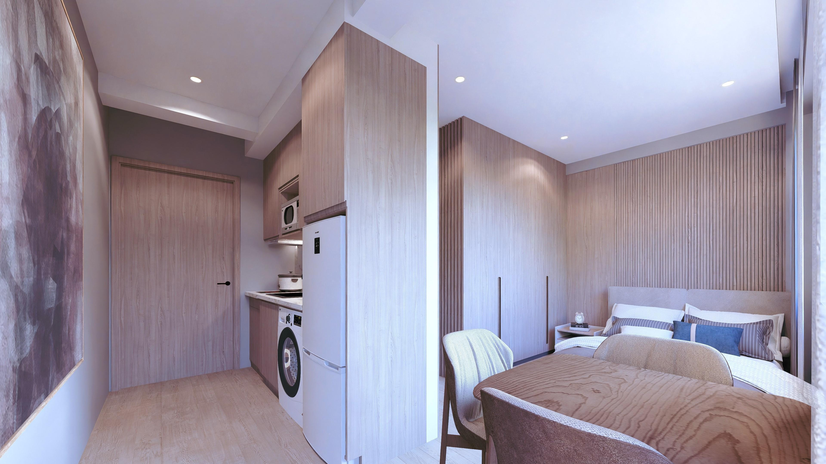
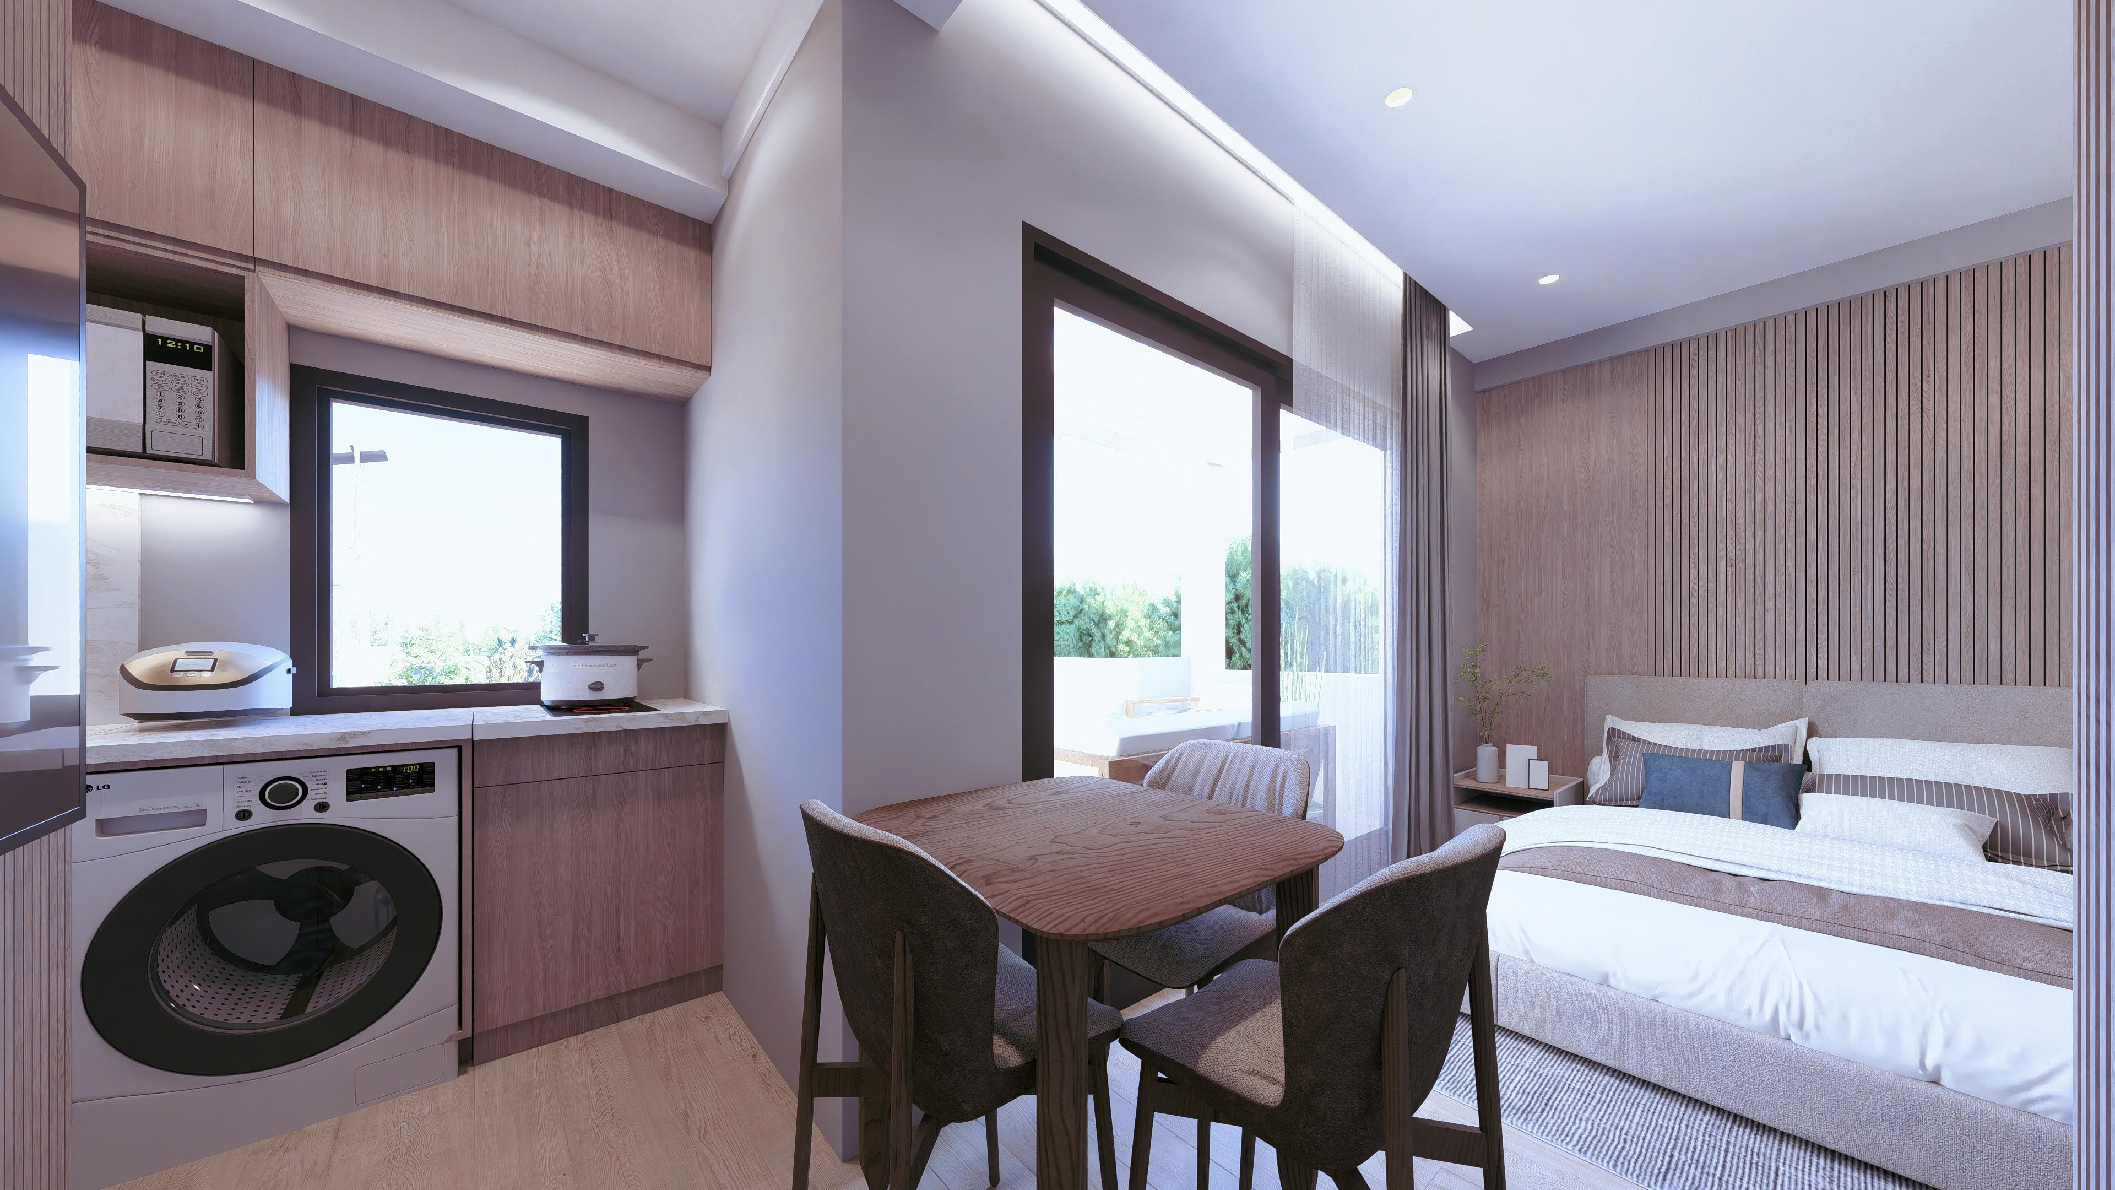
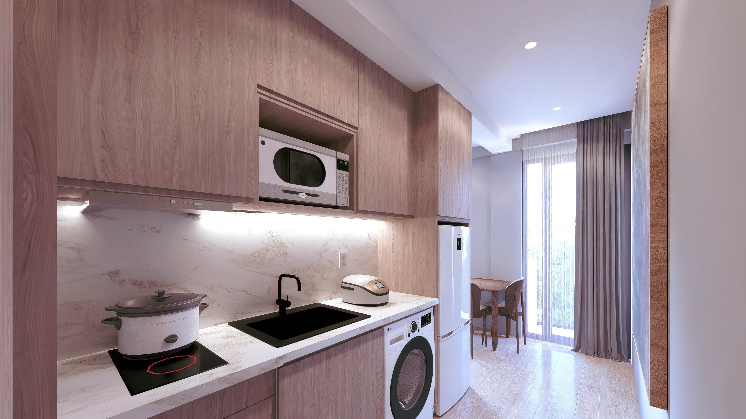
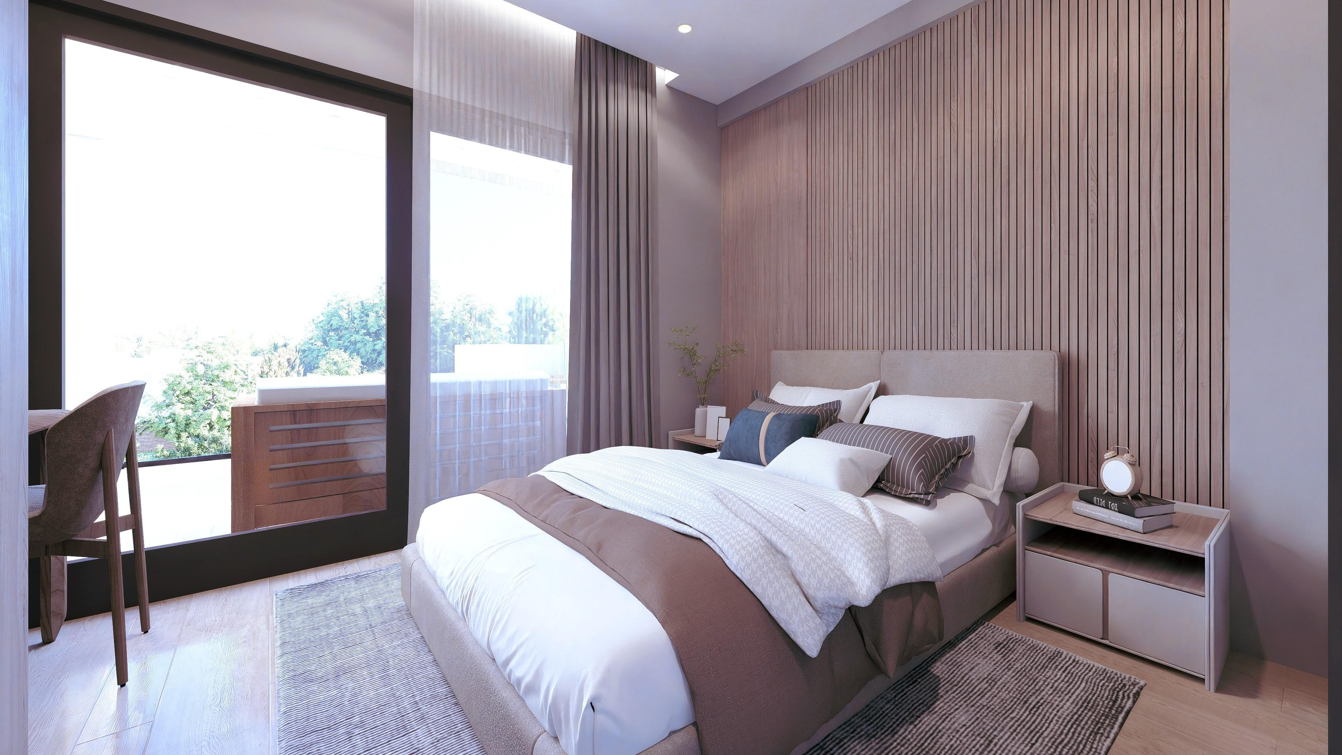
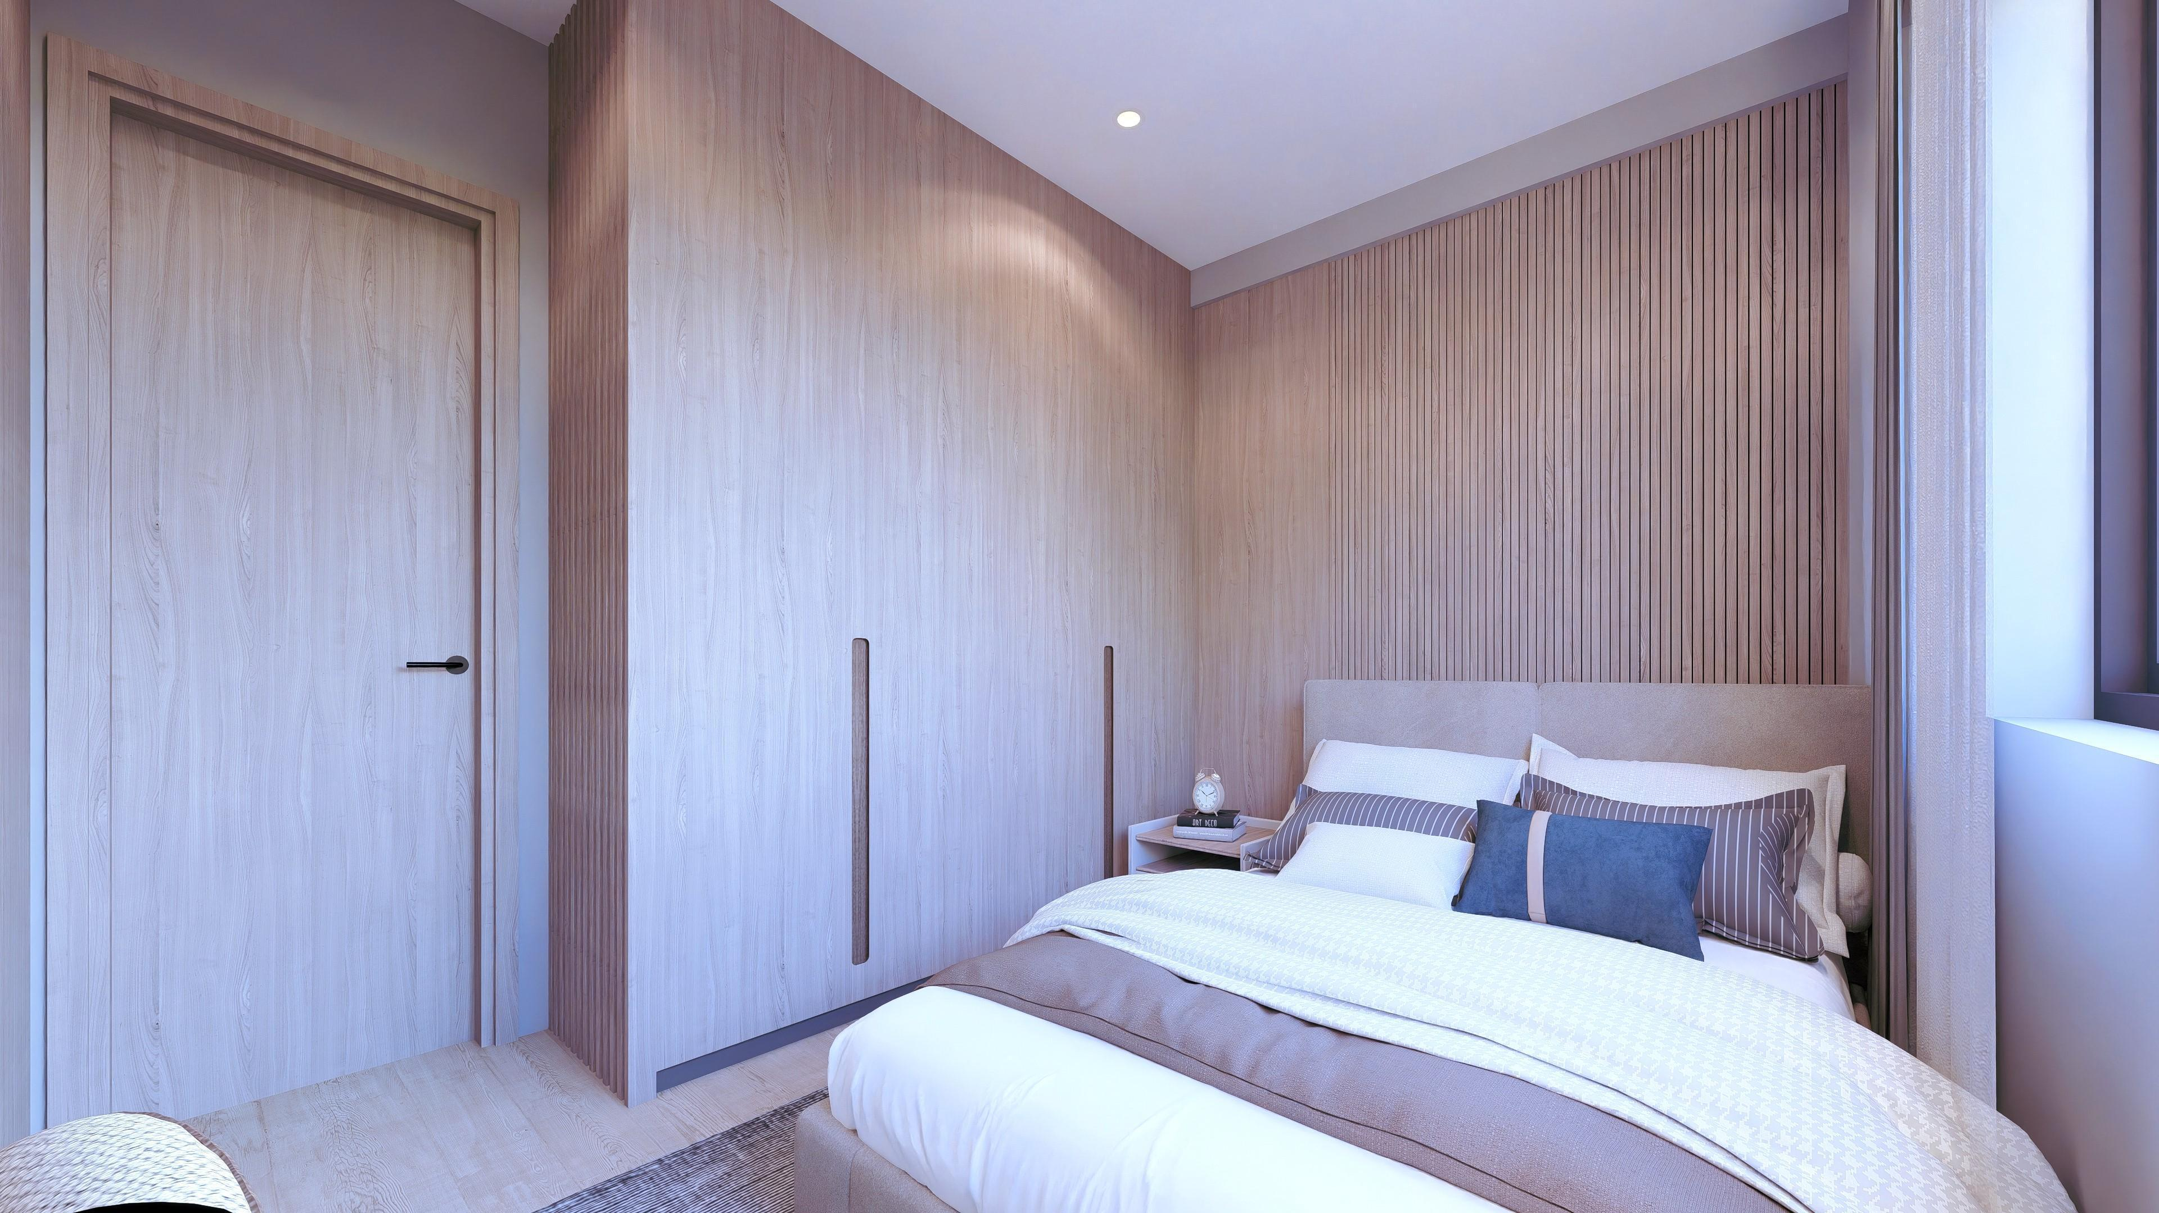
C1
60.37m²
Balcony sq.m: 16.19
studio 1
studio 2
The renderings are for reference only.

Slide 12
C1
60.37m²
Balcony sq.m: 16.19
studio 2
The renderings are for reference only.

Slide 13
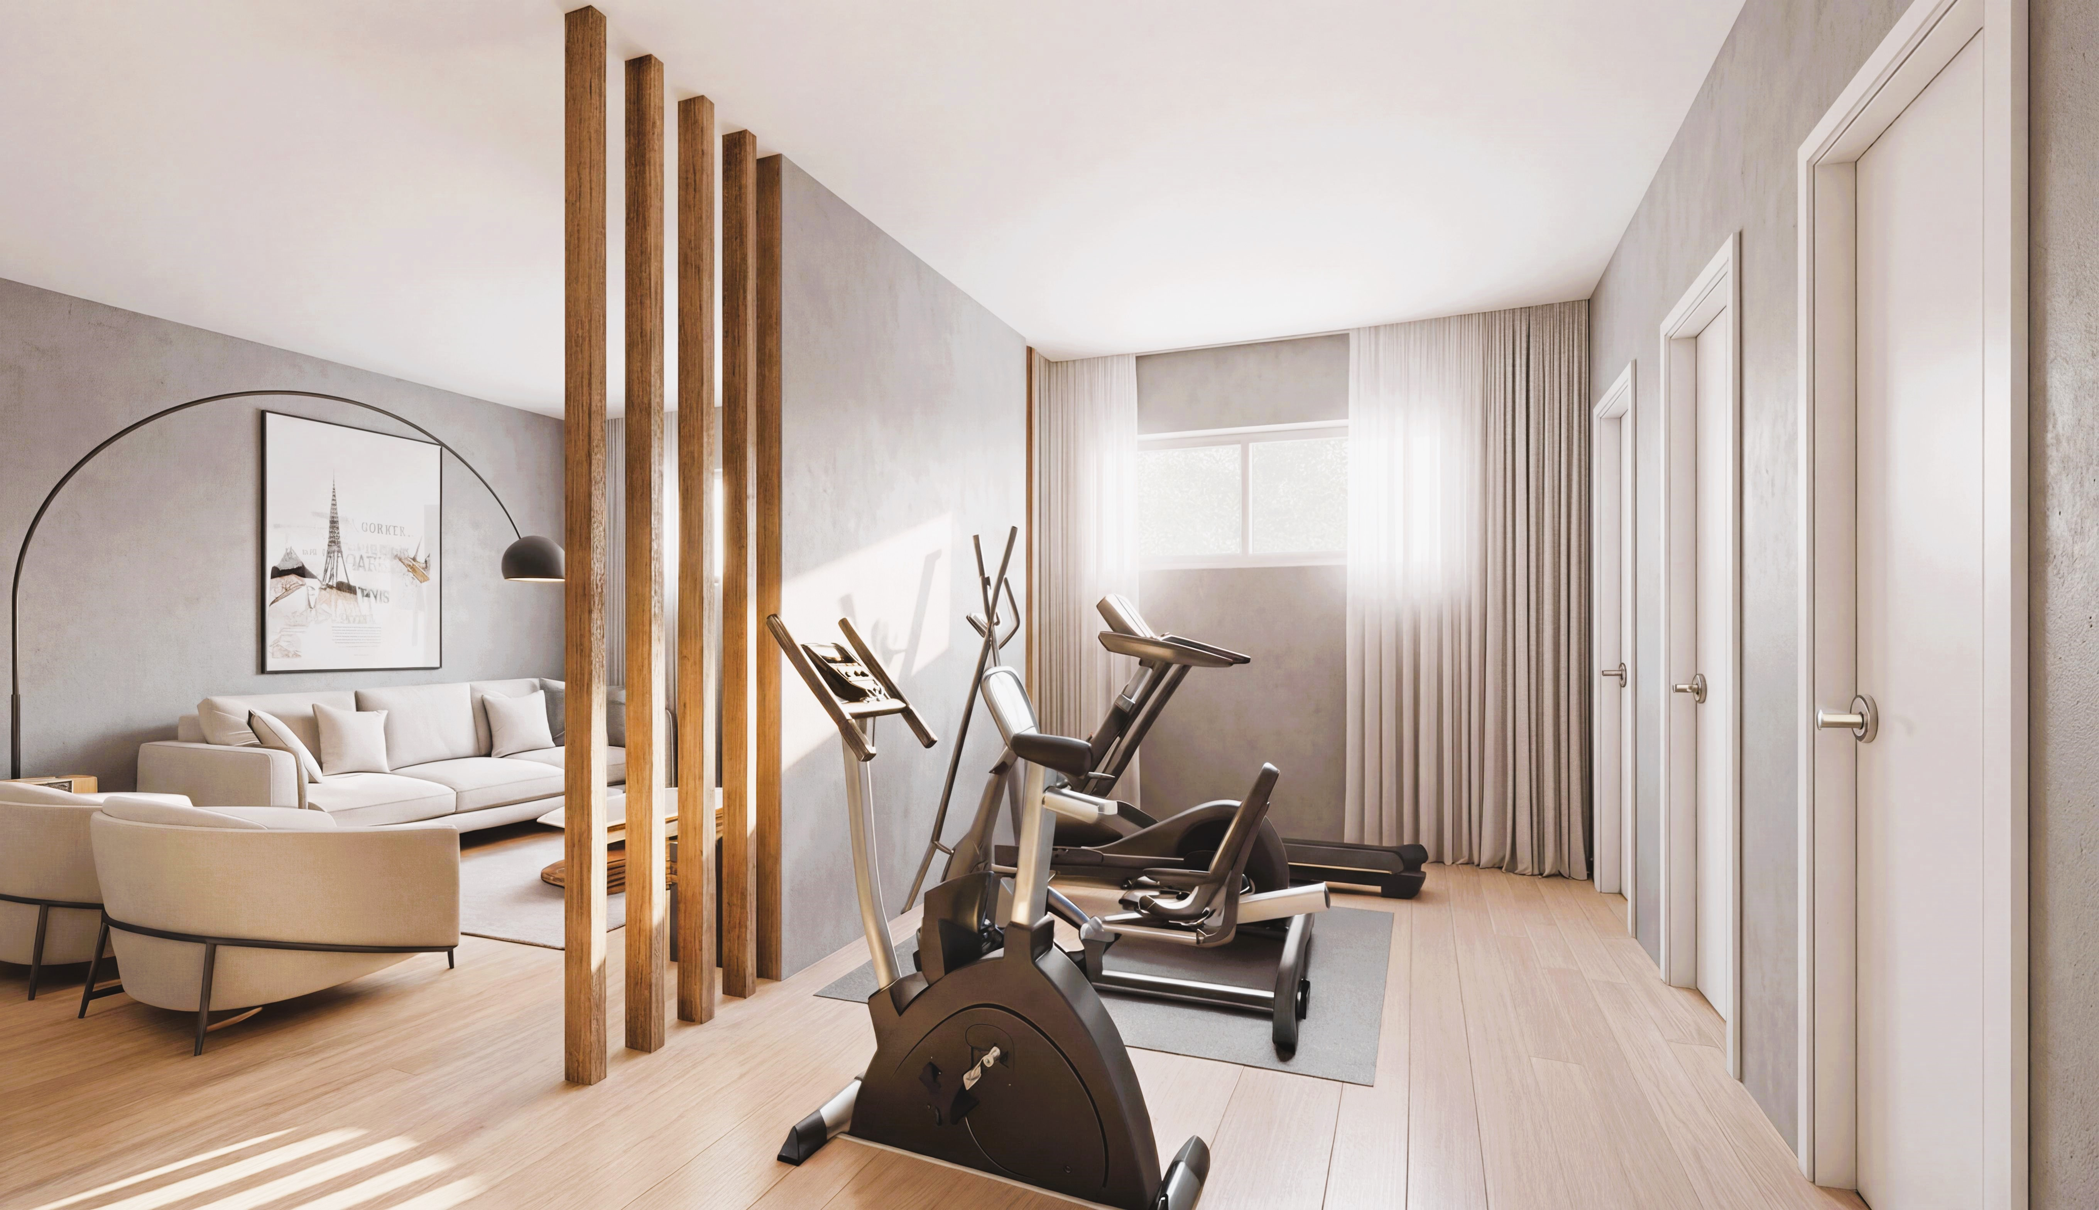
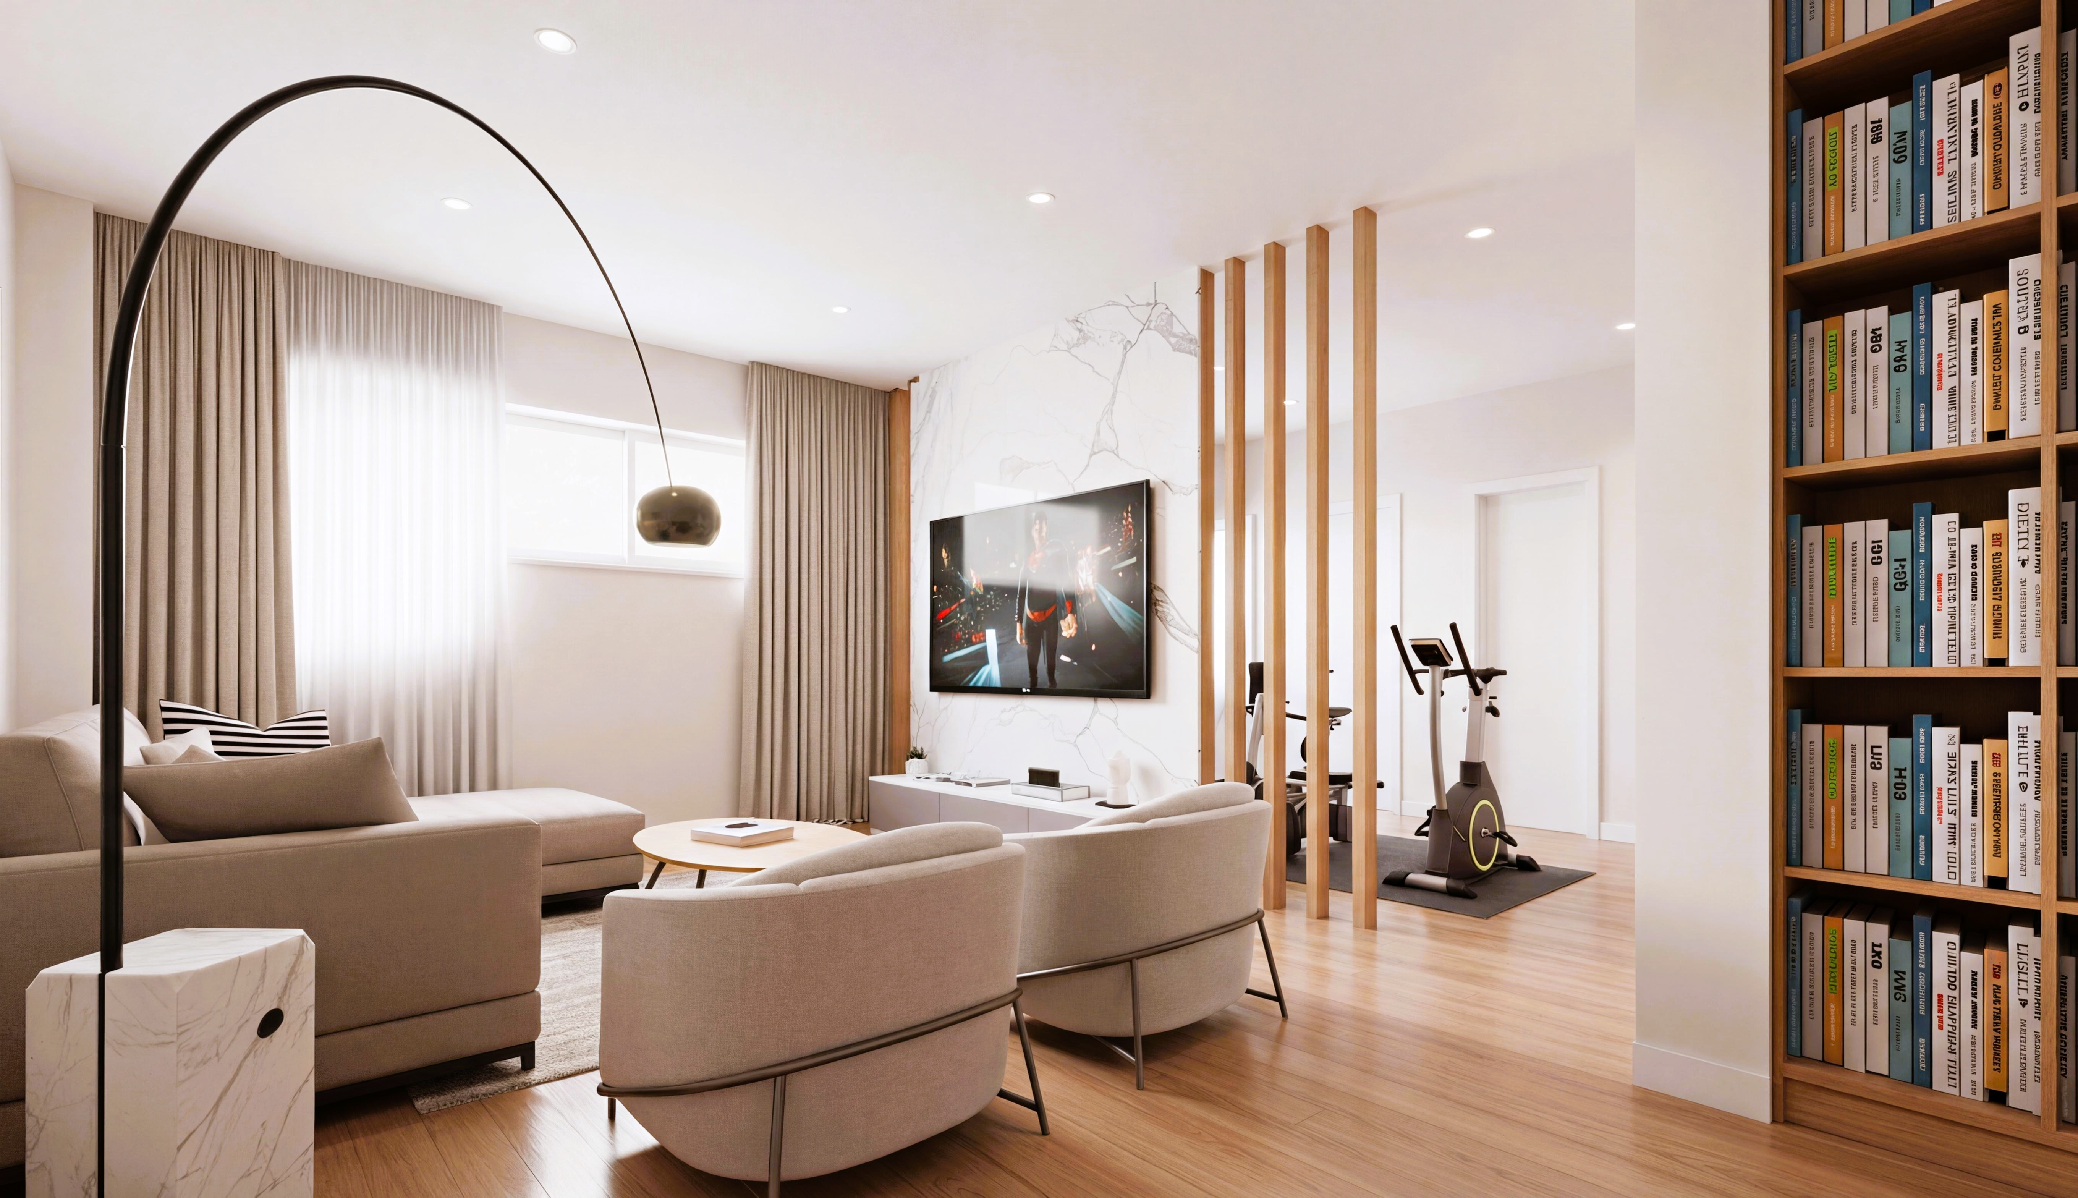



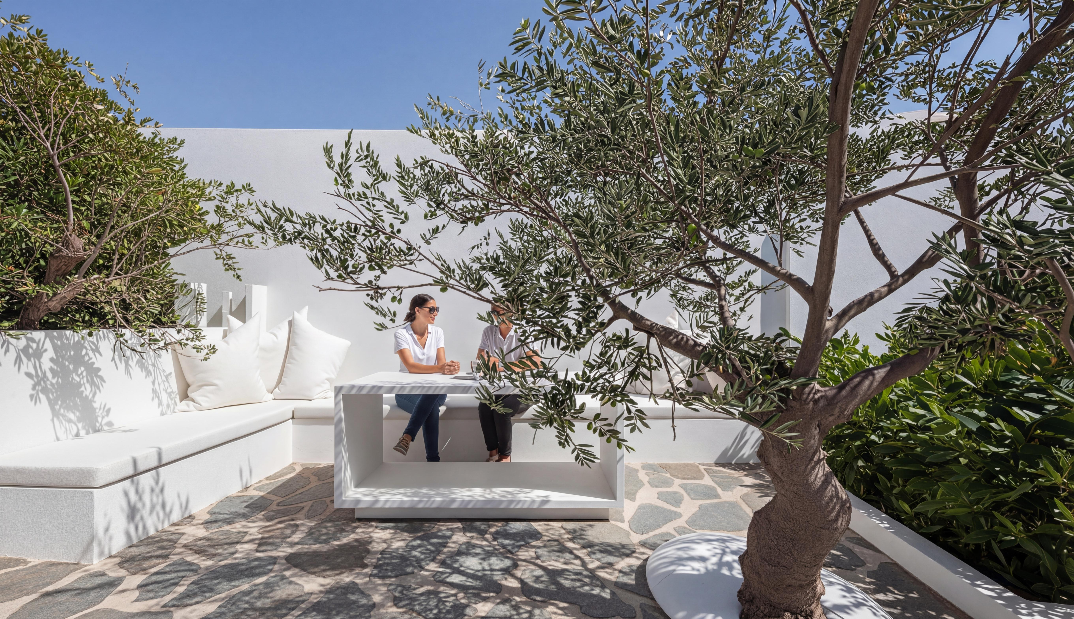
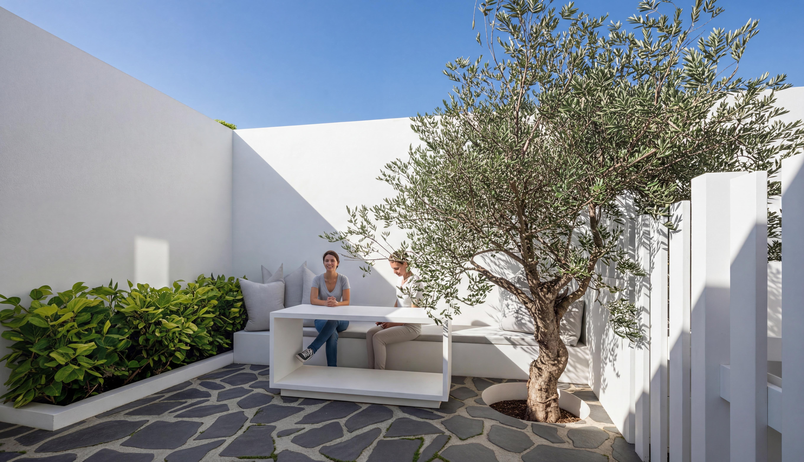
PUBLIC SHARED SPACE
GYM
Storage areas
●
Recreation area
Garden comon area
Greek Island Getaway

